Slide 1

Data Mining (Logistic Regression)
Data Mining
Dr. Sajarwo Anggai, S.ST., M.T. NIDN : 0421108703

Slide 2
Data Mining : Pertemuan 3
Menyiapkan data training
Algoritma Regresi Logistik
Evaluasi Model
Tugas

Slide 3
Data Training
Siapkan data training dalam bentuk excel atau csv yang nantinya akan di load ke dalam Aplikasi.
Data dapat diambil di dalam negeri maupun luar negeri atau dibangun sendiri sesuai dengan kebutuhan.

Slide 4
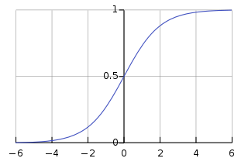
Logistic Regression (Regresi Logistik)
Regresi logistik (kadang disebut model logistik atau model logit), dalam statistika digunakan untuk prediksi probabilitas kejadian suatu peristiwa dengan mencocokkan data pada fungsi logit kurva logistik.
https://id.wikipedia.org/wiki/Regresi_logistik

Slide 5
Type of Logistic Regression
Binomial: In binomial Logistic regression, there can be only two possible types of the dependent variables, such as 0 or 1, Pass or Fail, etc.
Multinomial: In multinomial Logistic regression, there can be 3 or more possible unordered types of the dependent variable, such as “cat”, “dogs”, or “sheep”
Ordinal: In ordinal Logistic regression, there can be 3 or more possible ordered types of dependent variables, such as “low”, “Medium”, or “High”.
https://www.geeksforgeeks.org/understanding-logistic-regression/

Slide 6
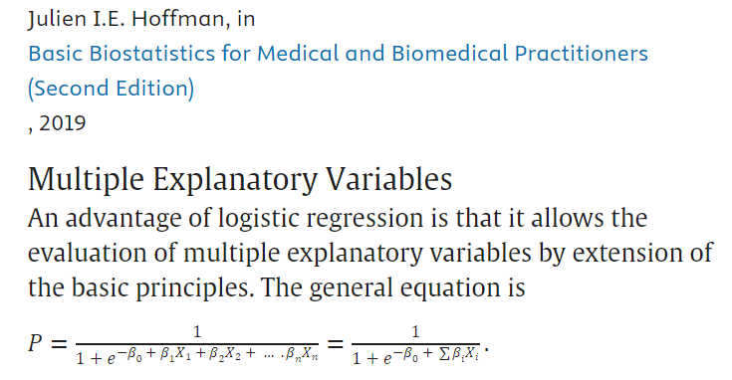
Formula
https://www.sciencedirect.com/topics/medicine-and-dentistry/logistic-regression-analysis

Slide 7
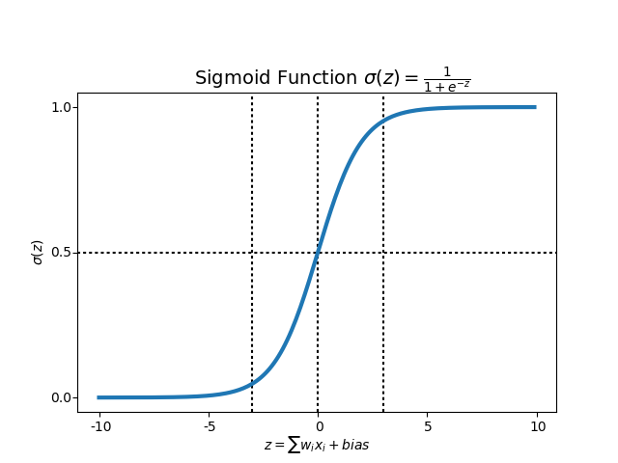
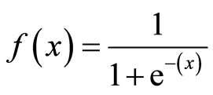
Sigmoid Activation Function

Slide 8
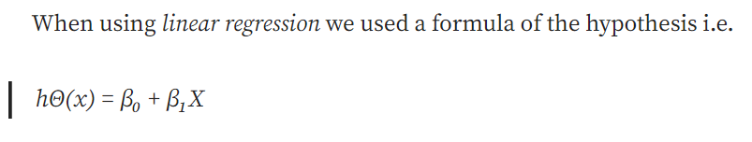
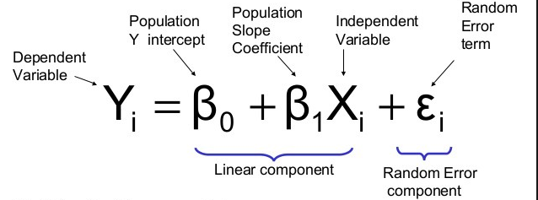
Rumus Linear masih ingat???
Independent Variable
Intercept
Slope
https://towardsdatascience.com/introduction-to-logistic-regression-66248243c148

Slide 9
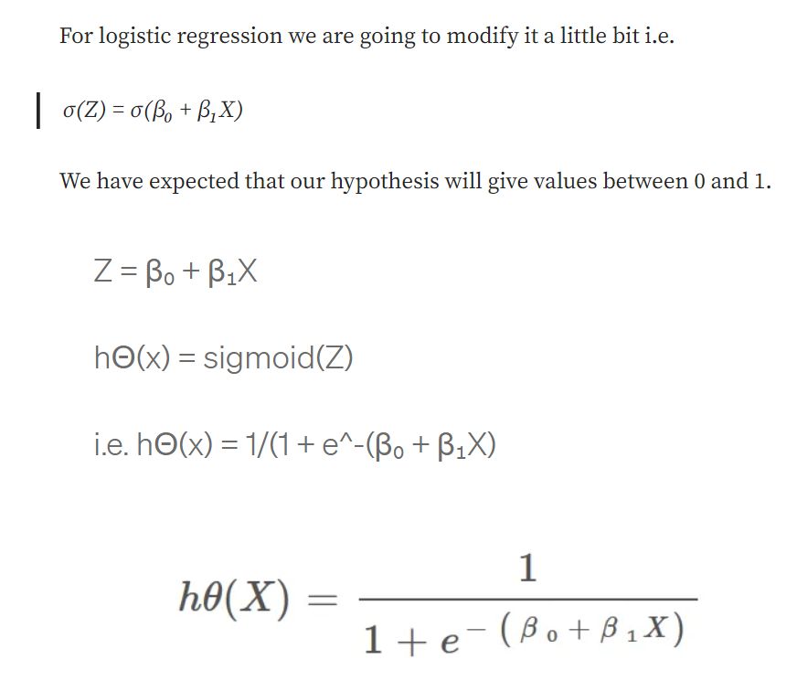
Sigmoid Function
https://towardsdatascience.com/introduction-to-logistic-regression-66248243c148

Slide 10
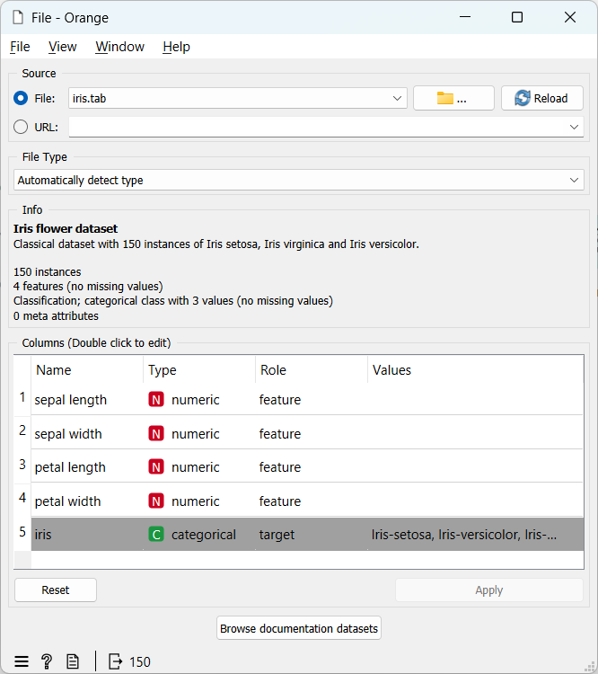
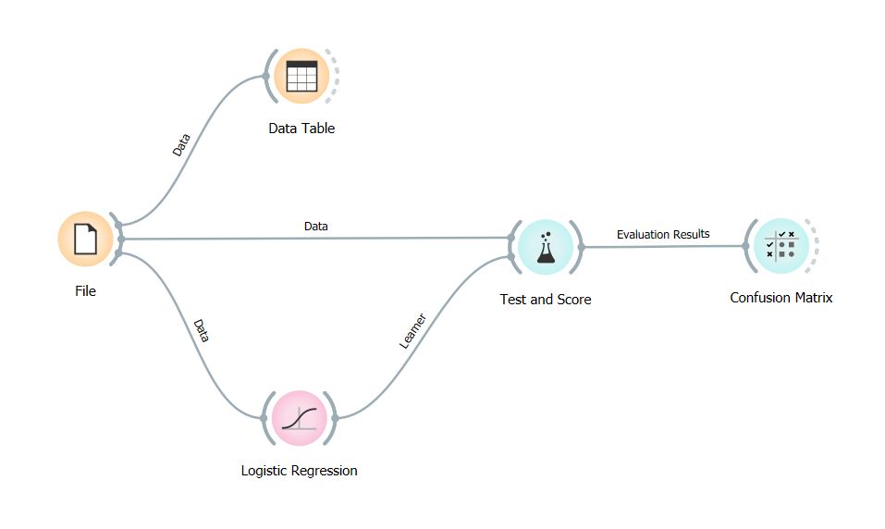
Pembuatan Model 1

Slide 11
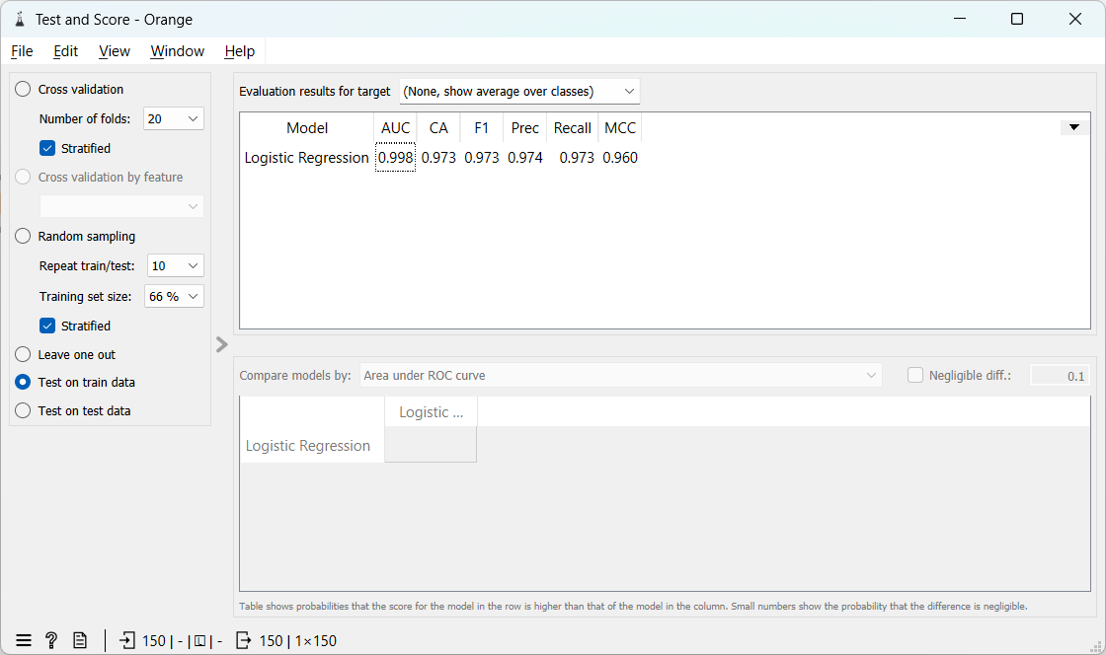
Test & Score

Slide 12

Cross Entropy
Cross Entropy adalah loss function yang banyak digunakan pada tugas klasifikasi. Cross Entropy mengukur perbedaan antara dua distribusi probabilitas untuk variabel acak tertentu atau serangkaian peristiwa.
Cross Entropy digunakan saat menyesuaikan bobot model selama training. Tujuannya adalah untuk meminimalkan loss, yaitu semakin kecil loss semakin baik modelnya. Model yang sempurna memiliki cross-entropy loss 0. Metode ini biasanya berfungsi untuk klasifikasi multi-kelas dan multi-label.
Cross-entropy dapat dihitung menggunakan probabilitas kejadian dari P dan Q, sebagai berikut:
https://www.trivusi.web.id/2022/08/loss-function.html

Slide 13
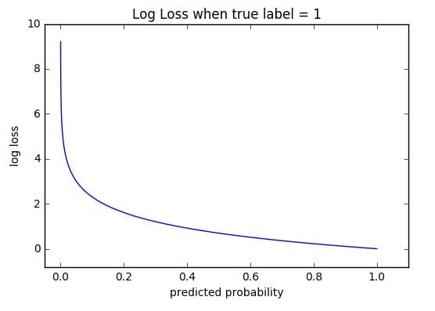

Log Loss
Log Loss, merupakan Binary Cross Entropy. Loss function jenis ini mengukur kinerja model klasifikasi, di mana outputnya adalah probabilitas dengan nilai antara 0 dan 1.
Saat probabilitas yang diprediksi semakin jauh dari label sebenarnya, Log loss akan meningkat. Model yang sempurna akan memiliki Log Loss 0.
https://www.trivusi.web.id/2022/08/loss-function.html

Slide 14
Model Evaluation (Evaluasi Model)
Area under ROC is the area under the receiver-operating curve.
Classification accuracy is the proportion of correctly classified examples.
F-1 is a weighted harmonic mean of precision and recall (see below).
Precision is the proportion of true positives among instances classified as positive, e.g. the proportion of Iris virginica correctly identified as Iris virginica.
Recall is the proportion of true positives among all positive instances in the data, e.g. the number of sick among all diagnosed as sick.
Specificity is the proportion of true negatives among all negative instances, e.g. the number of non-sick among all diagnosed as non-sick.
LogLoss or cross-entropy loss takes into account the uncertainty of your prediction based on how much it varies from the actual label.
Matthews correlation coefficient takes into account true and false positives and negatives and is generally regarded as a balanced measure which can be used even if the classes are of very different sizes.
https://orangedatamining.com/widget-catalog/evaluate/testandscore/

Slide 15
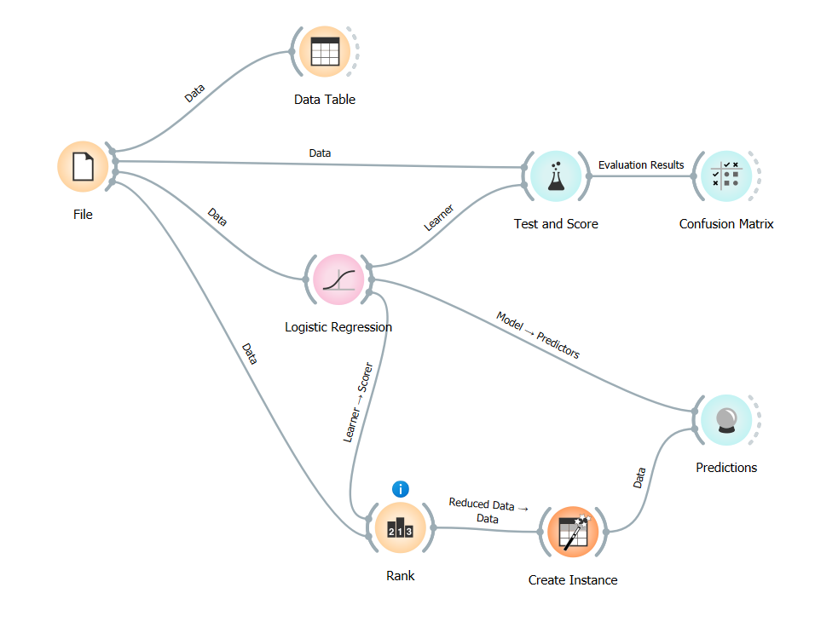
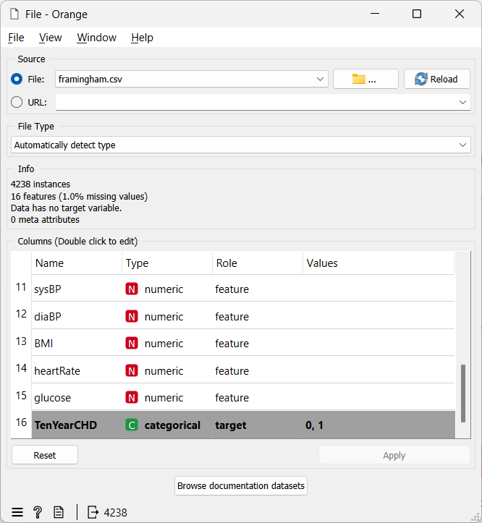
Pembuatan Model 2

Slide 16
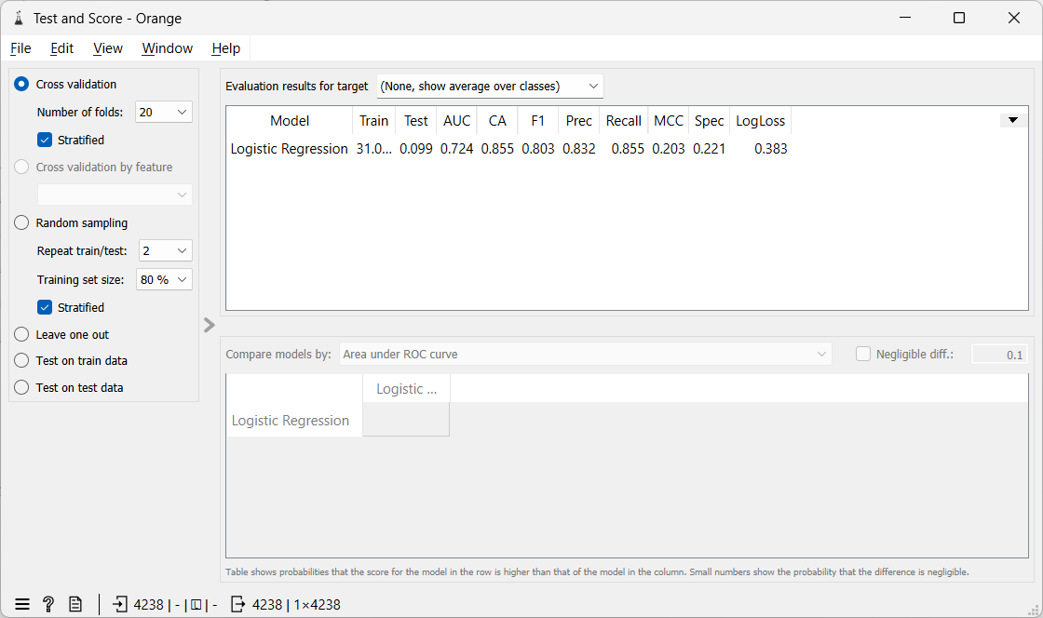

Slide 17
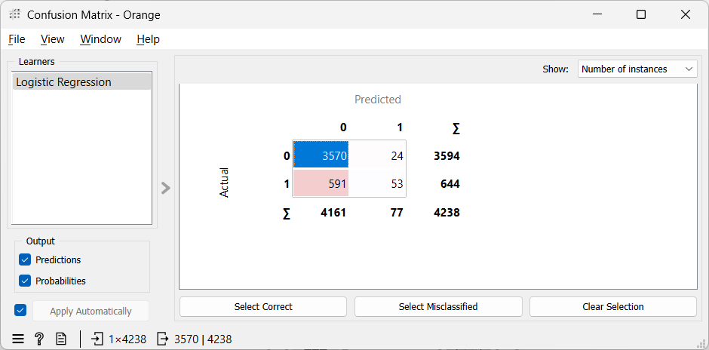
Confusion Matrix

Slide 18
Tugas
Buat Model untuk Regresi Logistik
Metrik Pengukuran Regresi Logistik + Confusion Matrix (Uraikan)
Kelebihan dan Kekurangan Regresi Logistik
Cari 10 Jurnal terkait pemanfaatan Regresi Logistik
Diskusikan dalam Forum
Tuliskan dalam laporan (dikumpulkan saat UTS)

Slide 19
Referensi Tambahan
https://sekolahstata.com/apa-itu-logistic-regression/
https://media.neliti.com/media/publications/31101-penerapan-metode-regresi-logistik-dalam-a796735e.pdf
https://www.datacamp.com/tutorial/understanding-logistic-regression-python
https://id.wikipedia.org/wiki/Regresi_logistik
https://en.wikipedia.org/wiki/Logistic_function
https://aws.amazon.com/id/compare/the-difference-between-linear-regression-and-logistic-regression/
https://towardsdatascience.com/introduction-to-logistic-regression-66248243c148
https://medium.com/@cmukesh8688/logistic-regression-sigmoid-function-and-threshold-b37b82a4cd79
https://realpython.com/logistic-regression-python
https://www.trivusi.web.id/2023/03/perbedaan-mae-mse-rmse-dan-mape.html
https://www.askpython.com/resources/regression-error-metrics
https://www.kaggle.com/datasets/deependraverma13/diabetes-healthcare-comprehensive-dataset

Slide 20

Universitas Pamulang
Magister Teknik Informatika
Sajarwo Anggai
Dosen – Universitas Pamulang
NIDN : 0421108703
Email : dosen02832@unpam.ac.id
WA : 082343006557
Terima Kasih

